Slide 1
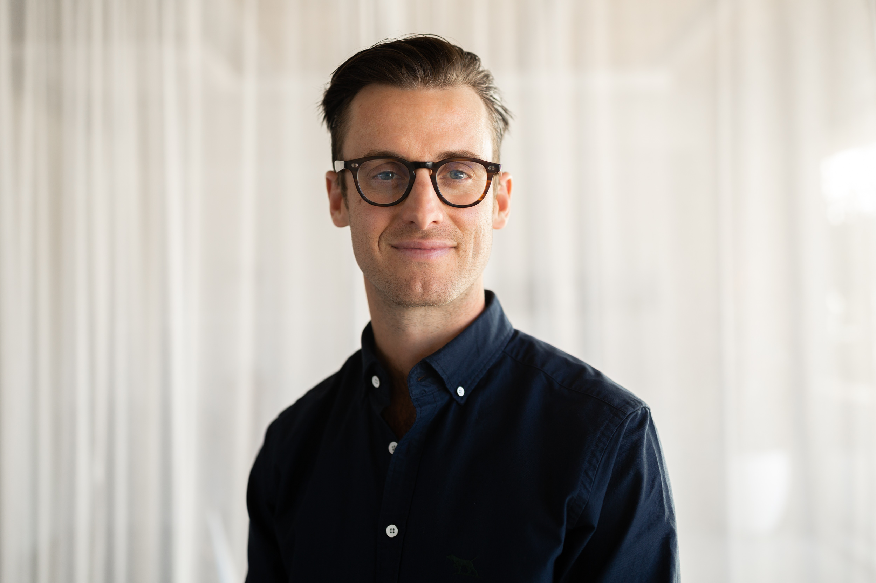
Central Branch Webinar
When: 17th November 2022 (Thursday), 5:30-6:30 pm
Where:
Palmerston North: Online
Wellington: FSANZ, Level 3, 154 Featherston St.
Online: Zoom -link will be provided once registration has been confirmed
Members &Students- FREE (gold coin donations are kindly accepted ☺)
Non-Members- $20
Speaker:
Angus Brown (Ārepa): A Brainfood Technology Company
Angus Brown is the founder of Ārepa, a brainfood technology company working at the nexus between nature and neuroscience to create clinically proven functional food that enhances cognition and health. Before founding Ārepa, Angus was Business Manager at The FoodBowl for 6 years helping companies large and small develop and commercialise new high-value F&B products for the local and export markets.
Angus Brown
Co-Founder / Co-CEO Ārepa

